Slide 1
Course : COMP8029 – IT Security and Risk Management
Period : September / February 20XX
Risk Management - Planning For Organizational Readiness
Session 04
KDS – Name SME

Slide 2
Overview of Risk Management
Risk management:
  Process of identifying vulnerabilities and taking carefully reasoned steps to ensure the confidentiality, integrity, and availability of the information system
  If you know the enemy and know yourself, you need not fear the result of a hundred battles. If you know yourself but not the enemy, for every victory gained you will also suffer a defeat. If you know neither the enemy nor yourself, you will succumb in every battle.
  - Chinese General Sun Tzu
BFS - Binus March 2011

Slide 3
Know Yourself
Know Yourself:
  Identify, examine, and understand the information and systems currently in place
  Assets = information and systems that use, store, and transmit information
    What are they?
    How do they add value to the organization?
    To which vulnerabilities are they susceptible?
    Have periodic review, revision, and maintenance of control mechanisms
BFS - Binus March 2011

Slide 4
Know the Enemy
Know the Enemy:
  Identify, examine, and understand the threats facing the organization
  Conduct periodic management reviews to create an asset inventory
  Identify current controls and mitigation strategies, including cost effectiveness and deployment issues
BFS - Binus March 2011

Slide 5
Risk Identification
Identify, classify, and prioritize information assets
Goal: protect assets from threats
Identify threats
Identify vulnerabilities of each asset
Identify controls that will limit possible losses in the event of attack
BFS - Binus March 2011

Slide 6
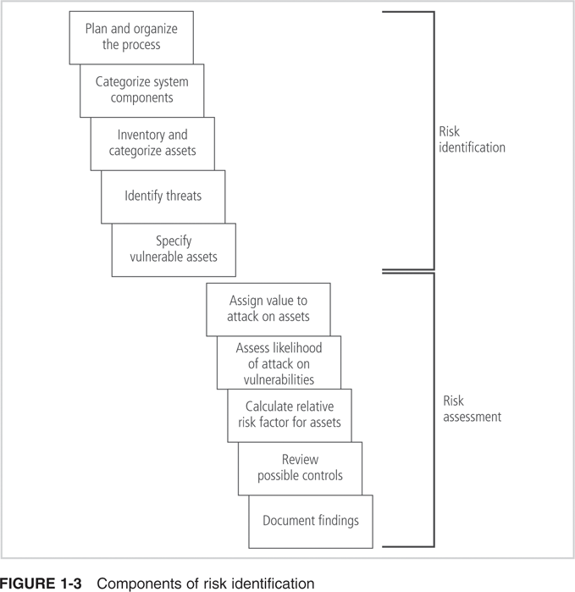
Risk Identification (continued)
BFS - Binus March 2011

Slide 7
Risk Identification (continued)
Asset Identification and Valuation:
  Identify each asset and assess its value
  Include people, procedures, data and information , software, hardware, and networking elements
  Classify and categorize the assets
Information Asset Classification:
  Classify the sensitivity and security priority of the data and devices that store, transmit, or process the data
  Classify the personnel security clearance structure – who is authorized to view what data
  Categories must be comprehensive and mutually exclusive
BFS - Binus March 2011

Slide 8
Risk Identification (continued)
Information Asset Valuation:
  Determine the criteria for valuation of assets or impact evaluation
    Which asset is most critical to the success of the organization?
    Which asset generates the most revenue? Most profitability?
    Which asset is most expensive to replace? To protect?
    If revealed, which asset would be most embarrassing or cause greatest liability?
BFS - Binus March 2011

Slide 9
Risk Identification (continued)
Calculate the relative importance of each asset using weighted factor analysis
Weighted factor analysis:
  Assign each asset a score from 0.1 to 1.0 for each critical factor
  Assign each critical factor a weight from 1 to 100
BFS - Binus March 2011

Slide 10
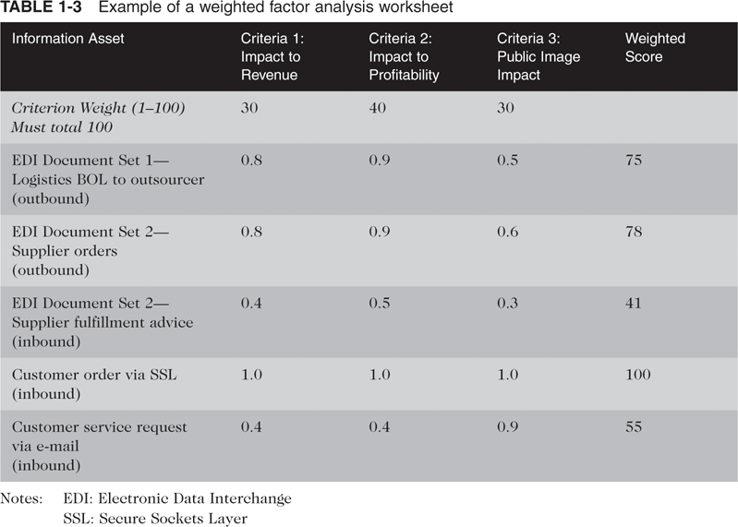
Risk Identification (continued)
BFS - Binus March 2011

Slide 11
Risk Identification (continued)
Data Classification and Management:
  Public: information for general public dissemination
  For official use: information that is not particularly sensitive but is not for public release
  Sensitive: information important to the business that could cause embarrassment or loss of market share if revealed
  Classified: information that requires utmost security; disclosure could severely impact the organization
  Personnel security clearances for information should be on a need-to-know basis
BFS - Binus March 2011

Slide 12
Risk Identification (continued)
Threat Identification:
  Conduct a threat assessment
    Which threats present a danger to the assets in the given environment?
    Which threats represent the most danger?
    What is the cost to recover from a successful attack?
    Which threats require the greatest expenditure to prevent?
BFS - Binus March 2011

Slide 13
Risk Identification (continued)
Vulnerability Identification:
  Examine each threat and list the assets and their vulnerabilities
  A threat may yield multiple vulnerabilities
  Diverse members of the organization should participate in this activity
BFS - Binus March 2011

Slide 14
Risk Assessment
Risk assessment:
  Process of assigning a risk rating or score to each information asset
  Goal is to determine the relative risk of each vulnerability using various factors
Likelihood:
  Probability that a specific vulnerability will be successfully attacked
  Many asset/vulnerability combinations have external references for likelihood values
BFS - Binus March 2011

Slide 15
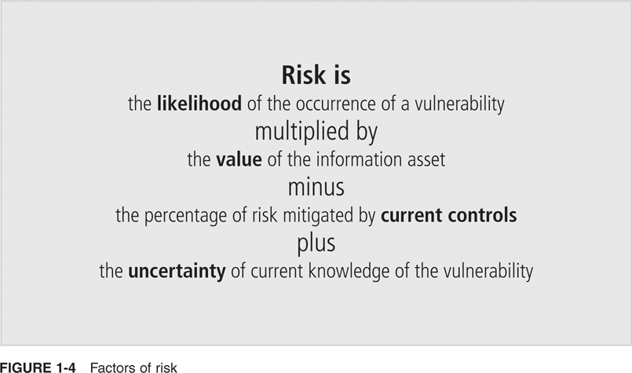
Risk Assessment (continued)
BFS - Binus March 2011

Slide 16
Risk Assessment (continued)
Valuation of Information Assets:
  Assign weighted scores to each asset’s value to the organization
    Which threats present a danger to the organization’s assets in the given environment?
    Which threats represent the most danger?
    What is the cost to recover from a successful attack?
    Which threats require the greatest expenditure to prevent?
    Which of the above questions is most important?
BFS - Binus March 2011

Slide 17
Risk Assessment (continued)
Risk Determination:
  Risk = [likelihood of vulnerability x value] x [1 - % risk already controlled + uncertainty]
  For Example: information asset A has a value score 50 and has one vulnerability that has a likelihood of 1.0 with no current control, and the estimate is that assumptions and data are 90% accurate.
BFS - Binus March 2011

Slide 18
Risk Assessment (continued)
Identify Possible Controls:
  Create a list of control ideas
  Residual risk: risk that remains after a control has been applied
Three general categories of controls:
  Policies
  Programs
  Technologies
BFS - Binus March 2011

Slide 19
Risk Assessment (continued)
Policies:
  Documents that specify an approach to security
3 types of policies:
  Enterprise information security policy
  Issue-specific policies
  Systems-specific policies
Programs: activities performed within the organization to improve security
Security technologies: implementations of policies using technology-based mechanisms
BFS - Binus March 2011

Slide 20
Risk Control Strategies
Four basic strategies:
  Avoidance: Apply safeguards that eliminate or reduce the remaining uncontrolled risks
  Transference: Transfer the risk to other areas or to outside entities
  Mitigation: Reduce the impact should the vulnerability be exploited
  Acceptance: Understand the consequences and accept the risk without controls or mitigation
BFS - Binus March 2011

Slide 21
Risk Control Strategies (continued)
Avoidance:
  Attempts to prevent the exploitation of the vulnerability
  Preferred approach
Methods of avoidance:
  Application of policy
  Training and education
  Application of technology
BFS - Binus March 2011

Slide 22
Risk Control Strategies (continued)
Transference:
  Attempts to shift the risk to other assets, processes, or organizations
Methods of transference:
  Rethink how services are offered
  Revise deployment models
  Outsource to other organizations
  Purchase insurance
  Implement service contracts with providers
BFS - Binus March 2011

Slide 23
Risk Control Strategies (continued)
Mitigation:
  Attempts to reduce the impact caused by exploitation of a vulnerability through planning and preparation
Methods of mitigation:
  Contingency planning, which includes:
    Business impact analysis
    Incident response plan
    Disaster recovery plan
    Business continuity plan
Requires:
  Early detection that an attack is in progress
  Ability to respond quickly, efficiently, and effectively
BFS - Binus March 2011

Slide 24
Risk Control Strategies (continued)
Acceptance:
  The choice to do nothing to protect a vulnerability and to accept the outcome of its exploitation
Only valid when the organization has:
  Determined the level of a risk
  Assessed the probability of attack
  Estimated the potential damage that could occur
  Performed a thorough cost-benefit analysis
  Evaluated controls
  Decided that the asset did not justify the cost of protection
BFS - Binus March 2011

Slide 25
Contingency Planning and its Components
Contingency plan:
  Is prepared to anticipate, react to, and recover from events that threaten assets
  Focuses on steps required to restore normal operations
Four subordinate functions in a contingency plan:
  Business impact assessment
  Incident response planning
  Disaster recovery planning
  Business continuity planning
BFS - Binus March 2011

Slide 26
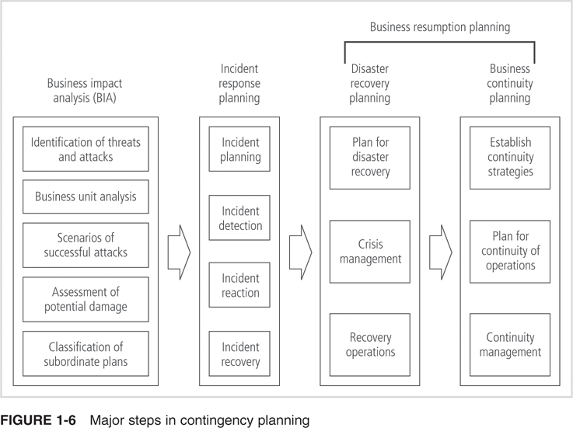
Contingency Planning Timeline (continued)
BFS - Binus March 2011

Slide 27
Contingency Planning and its Components (continued)
Business Impact Analysis (BIA):
  Investigation and assessment of the impact of attacks
  Adds detail to the prioritized list of threats and vulnerabilities created in the risk management process
  Provides detailed scenarios of potential impact of each type of attack
BFS - Binus March 2011

Slide 28
Contingency Planning and its Components (continued)
Incident Response Plan (IRP):
  Deals with the identification, classification, response, and recovery from an incident
  Details the specific steps to be taken when responding to a specific type of attack
Incident: any clearly identified attack on assets
Absence of an IR plan can lead to:
  Extensive damage to data, systems, and networks
  Additional damage due to uneducated staff
  Negative exposure in the news media
  Possible legal liability
BFS - Binus March 2011

Slide 29
Contingency Planning and its Components (continued)
Disaster Recovery Plan (DRP):
  Deals with preparation for and recovery from a natural or man-made disaster
  Can include strategies to limit losses before and during the disaster
  Includes:
    Preparations for the recovery process
    Strategies to limit losses during the disaster
    Detailed steps to follow when immediate danger has passed
DRP focuses on preparation before and actions after the incident; IRP focuses on actions during the incident
BFS - Binus March 2011

Slide 30
Contingency Planning and its Components (continued)
Business Continuity Plan (BCP):
  Expresses how to ensure that critical business functions continue at an alternate location after a catastrophic incident or disaster
  Used when the DRP cannot restore operations at the primary site
  Is the most strategic and long-term plan
Business Resumption Plan (BRP):
  Emerging new concept in contingency planning
  Merges the DRP and BCP into a single process
BFS - Binus March 2011

Slide 31
Contingency Planning Timeline
Steps in Contingency Planning:
  IRP focuses on immediate response; if attack is disastrous, the process moves to the DRP and BCP
  DRP focuses on restoration at the original site
  BCP runs concurrently with DRP when damage is major or long-term, or requires an alternate site
Can distinguish the IRP, DRP, and BCP by examining when each comes into play during the life of an incident
BFS - Binus March 2011

Slide 32
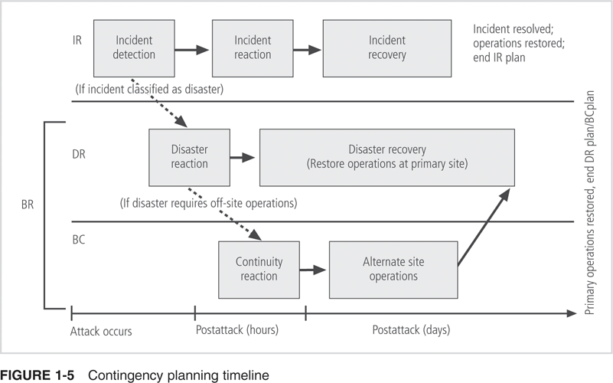
Contingency Planning Timeline (continued)
BFS - Binus March 2011

Slide 33
Contingency Planning Timeline (continued)
BFS - Binus March 2011

Slide 34
Contingency Planning Timeline (continued)
7 steps in NIST-sanctioned contingency planning:
  Develop the contingency planning policy statement
  Conduct the business impact analysis (BIA)
  Identify preventative measures and controls
  Develop recovery strategies
  Develop an IT contingency plan
  Plan testing, training, and exercises
  Plan maintenance
BFS - Binus March 2011

Slide 35
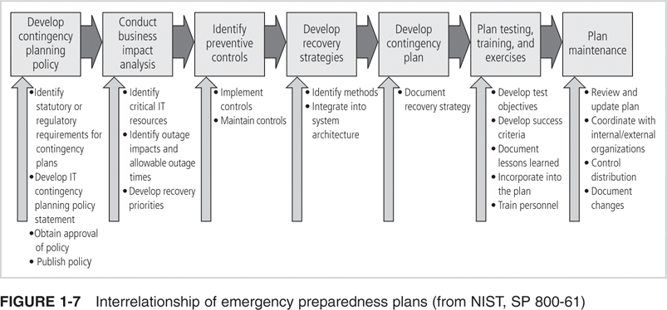
Contingency Planning Timeline (continued)
BFS - Binus March 2011

Slide 36
Information Security Policy in Developing Contingency Plans
Policy is needed to enforce requirements for protection of information before, during, and after an incident
Information security is primarily a management problem, not a technical one
Shaping policy is difficult because :
  It must never conflict with laws
  It must be properly administered
BFS - Binus March 2011

Slide 37
Key Policy Definitions
Policy:
  A plan or course of action used to convey instructions from senior management to those who make decisions, take actions, and perform duties
  An organizational law that dictates acceptable and unacceptable behavior, and defines penalties for violations
Standard:
  Detailed statement of what must be done to comply with policy
  De facto standard – informal standard
  De jure standard – formal standard
BFS - Binus March 2011

Slide 38
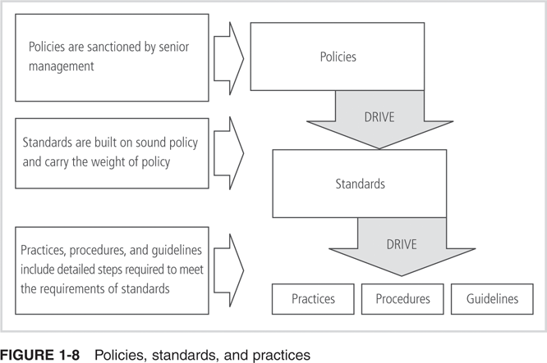
Key Policy Definitions (continued)
BFS - Binus March 2011

Slide 39
Key Policy Definitions (continued)
Mission: written statement of an organization’s purpose
Vision: written statement about organization’s goals
Strategic planning: process of moving the organization toward its vision
Information security policy: provides rules for the protection of information assets
3 types of security policy:
  Enterprise information security policy
  Issue-specific security policies
  Systems-specific security policies
BFS - Binus March 2011

Slide 40
Enterprise Information Security Policy
Enterprise Information Security Policy (EISP):
  Also called general security policy, IT security policy, or information security policy
  An executive-level document that sets the strategic direction, scope, and tone for all security efforts
  Contains the requirements to be met
  Assigns responsibilities for areas of security
  Addresses legal compliance
BFS - Binus March 2011

Slide 41
Issue-Specific Security Policy
Issue-Specific Security Policy (ISSP):
  Addresses specific areas of technology
  3 common approaches to creating ISSPs:
    Independent ISSP documents, each tailored to a specific issue
    Single comprehensive ISSP document covering all issues
    Modular ISSP document that unifies policy creation and administration while maintaining each specific issue’s requirements
BFS - Binus March 2011

Slide 42
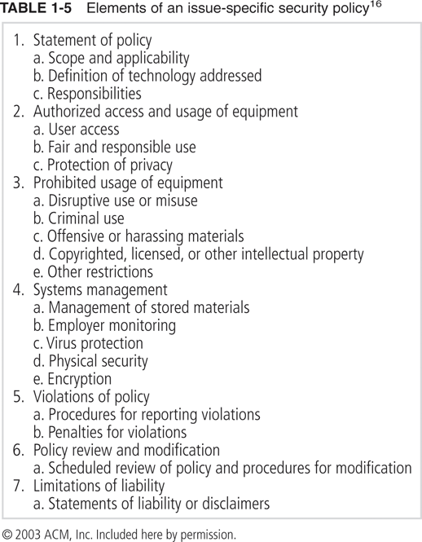
Issue-Specific Security Policy (continued)
BFS - Binus March 2011

Slide 43
Issue-Specific Security Policy (continued)
Statement of Policy: defines scope, who is responsible for implementation, and the technologies and issues being addressed
Authorized Access and Usage of Equipment: defines who can use the technology and how it can be used
Prohibited Usage of Equipment: defines what the technology cannot be used for
Systems Management: defines what responsibilities belong to management and to users
BFS - Binus March 2011

Slide 44
Issue-Specific Security Policy (continued)
Violations of Policy: specifies penalties and how to report suspected violations
Policy Review and Modification: procedures and timetable for periodic review to keep it relevant
Limitations of Liability: indicates that the company will not protect nor be liable for users’ unauthorized use of equipment
BFS - Binus March 2011

Slide 45
Systems-Specific Policy
Systems-Specific Security Policies (SysSPs):
  Standards and procedures to be used when configuring or maintaining systems
  Two general groups:
    Access control lists (ACLs): define rights and privileges of a particular user to a particular system
    Configuration rules: specific configuration codes entered into security systems
BFS - Binus March 2011

Slide 46
Systems-Specific Policy (continued)
ACL Policies:
  Are translated into sets of configurations to control access to systems
  Regulate who, what, when, and where access can occur
  Also called capability tables, user profiles, or user policies
Rule Policies:
  Specific to the operation of a system, such as configuration for firewalls, intrusion detection systems, and proxy servers
BFS - Binus March 2011

Slide 47
Policy Management
Policies are dynamic documents that change and grow, and must be disseminated in the organization
Security policies must contain:
  Individual responsible for the policy
  Schedule of reviews to ensure currency and accuracy
  Mechanism for revision recommendations to be made (preferably anonymously)
  Optionally, policy management software to manage creation, revision, and dissemination of policy
BFS - Binus March 2011

